Slide 1


IMDB Data from 2006-2016
Dataset of popular movies from the past 10 years

Slide 2
Hypothesis/Research Question
Based on the popular movies from 2006 - 2016 listed in the dataset, I want to specially check out and analysis:
Which variable or variables in this dataset will have a strong driving influence when choosing the most popular movies?

Slide 3
5 Variables chosen for this project
Revenue
Rating
Year
Runtime
Metascore

Slide 4
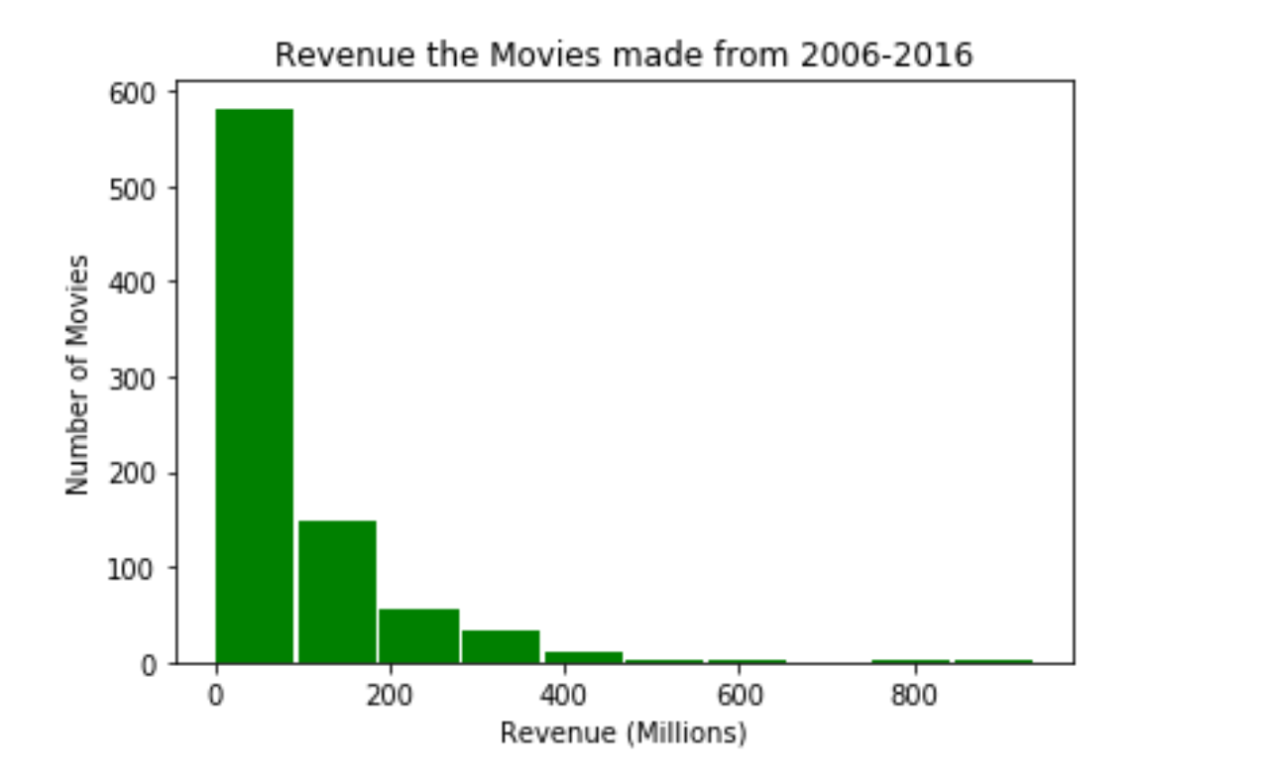
Initial Data Exploration stage – Creation of Histograms
For the start of the project we had to create histograms for the 5 variables just ot get a feel of the of the data from the chosen variables
Histogram of Revenue variable

Slide 5
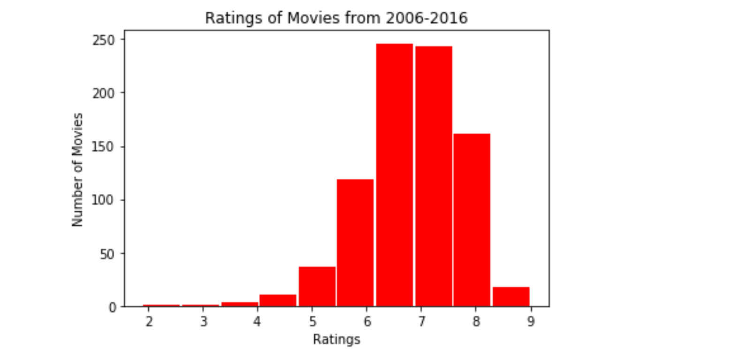
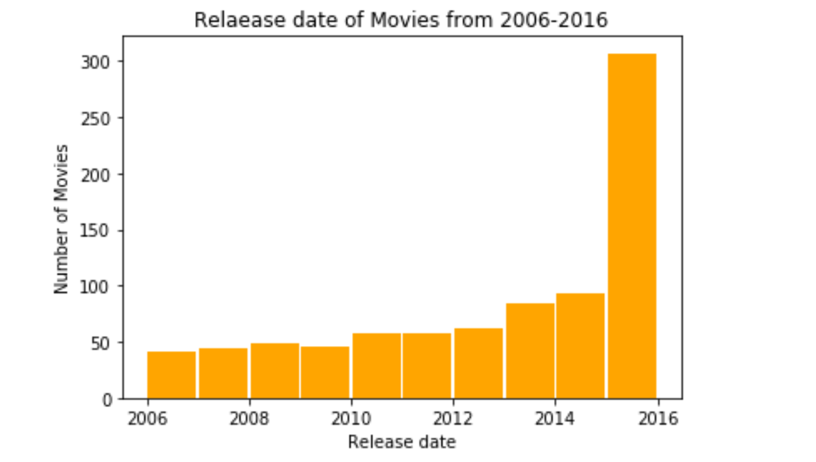
Histograms – Rating & Year variable

Slide 6
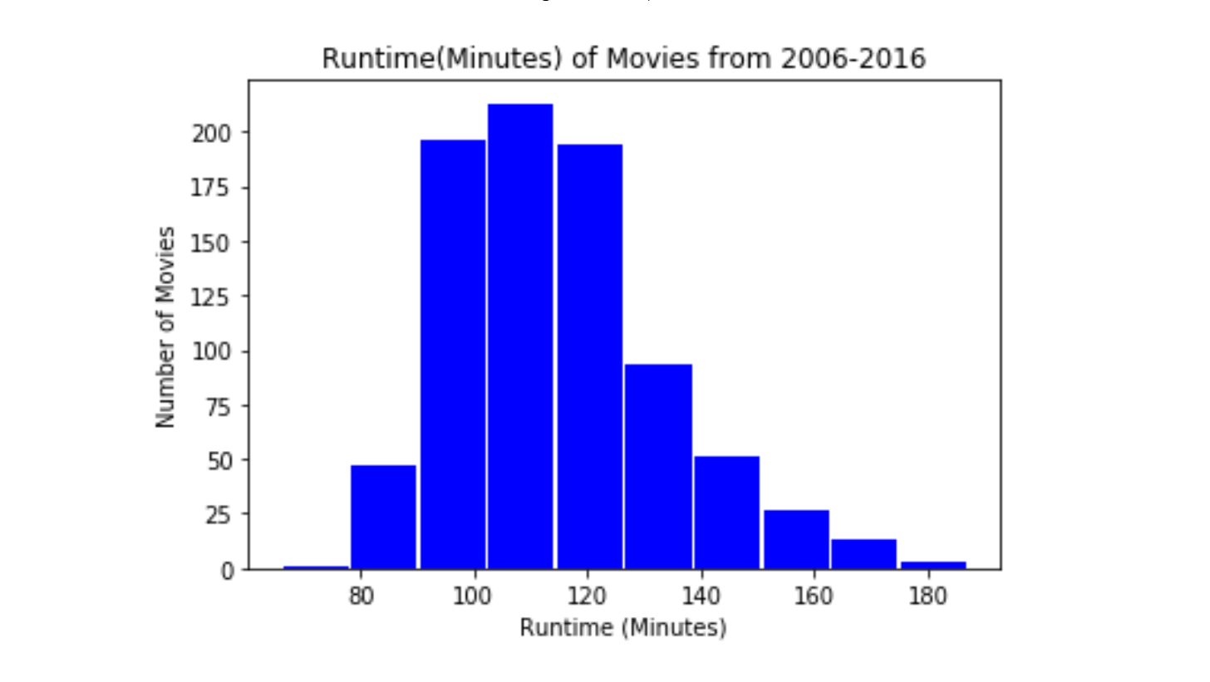
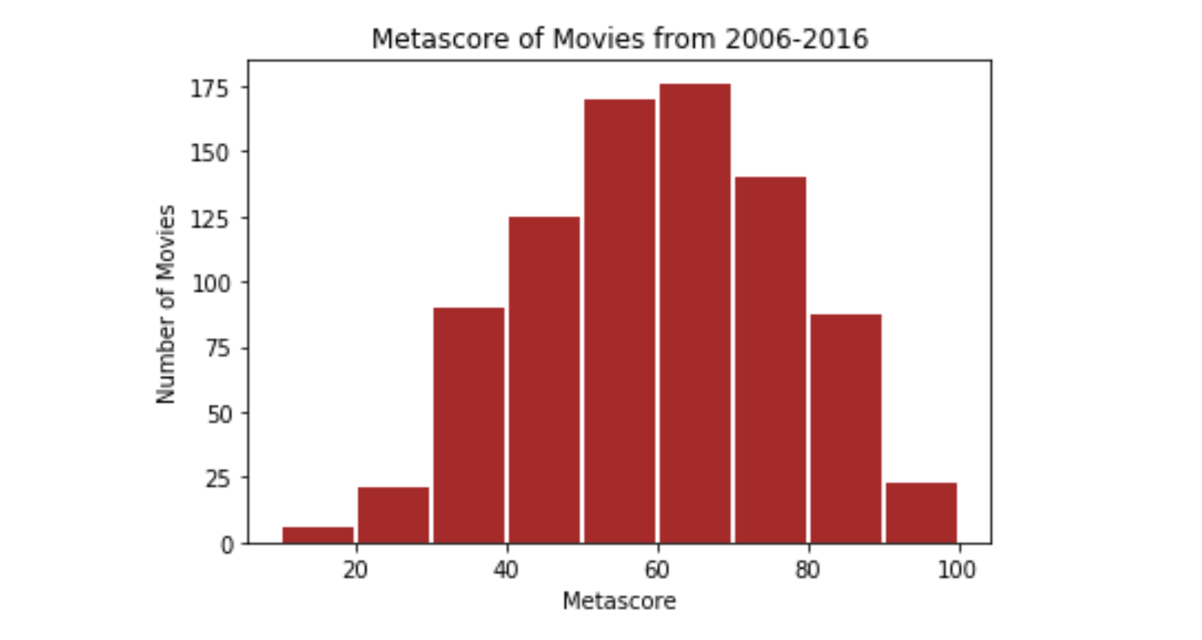
Histograms – Runtime & Metascore variable

Slide 7
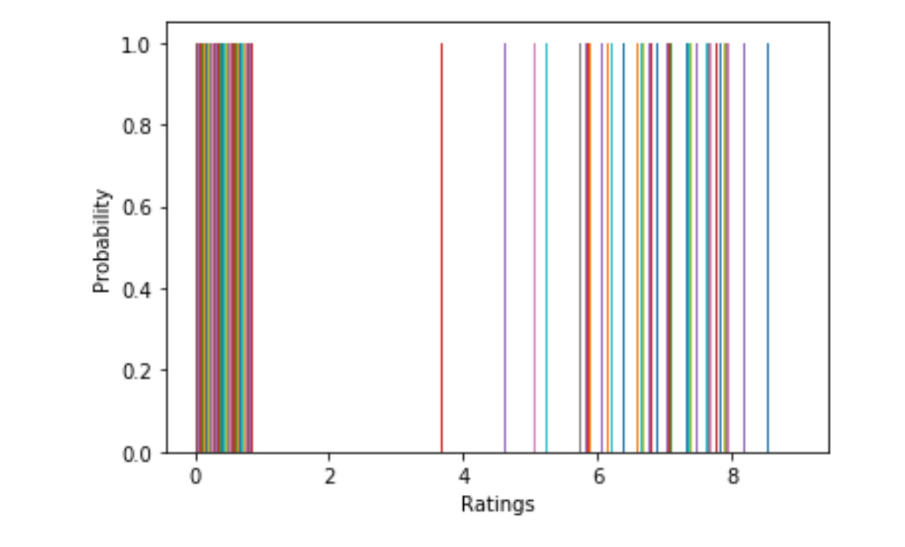
Probability Mass Function (PMF)
I chose Rating as a variable. Divided rating into two categories high and low and set th as a separate column.
Histogram of the PMF is below

Slide 8
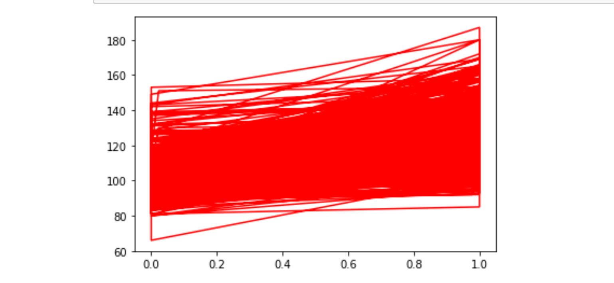
Analytical Distribution
I chose to apply an alatical distribution to the Runtime variable

Slide 9
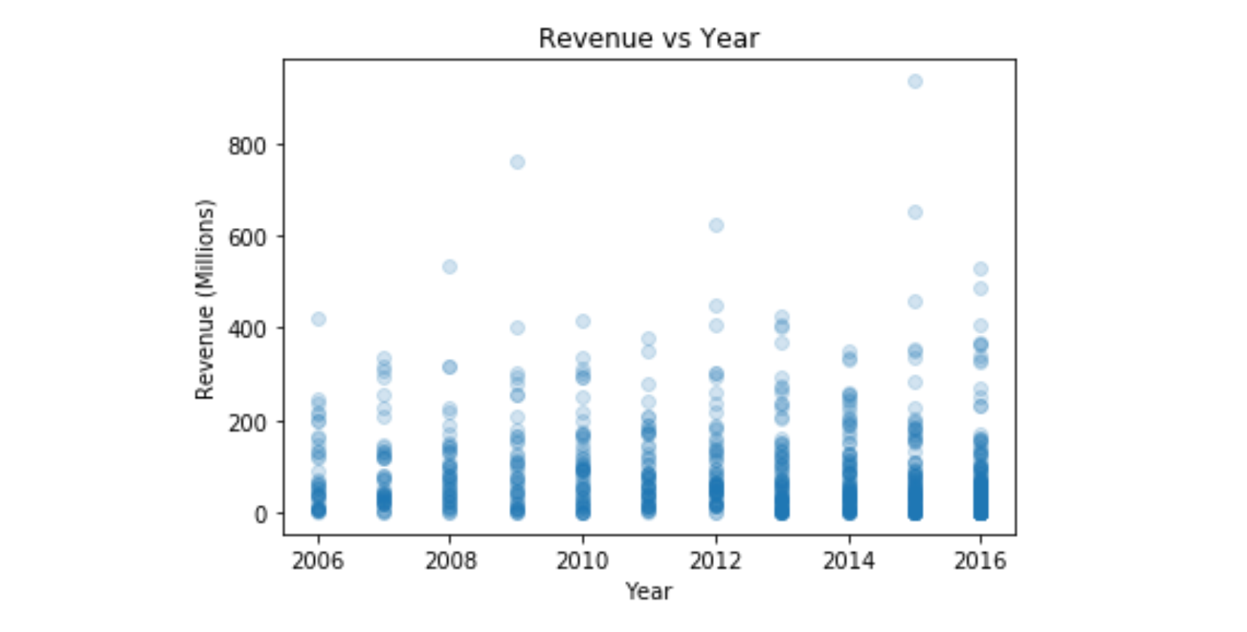
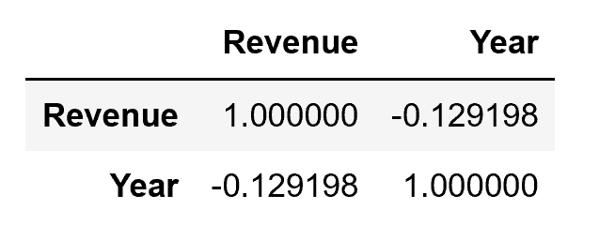
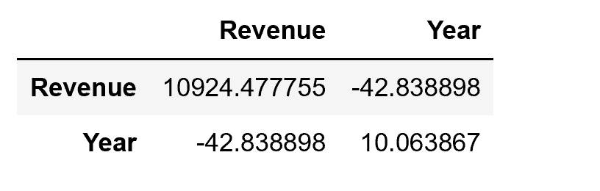
Scatterplot – Revenue variable with correlation and covariance
Pearson Correlation
Co-variance

Slide 10
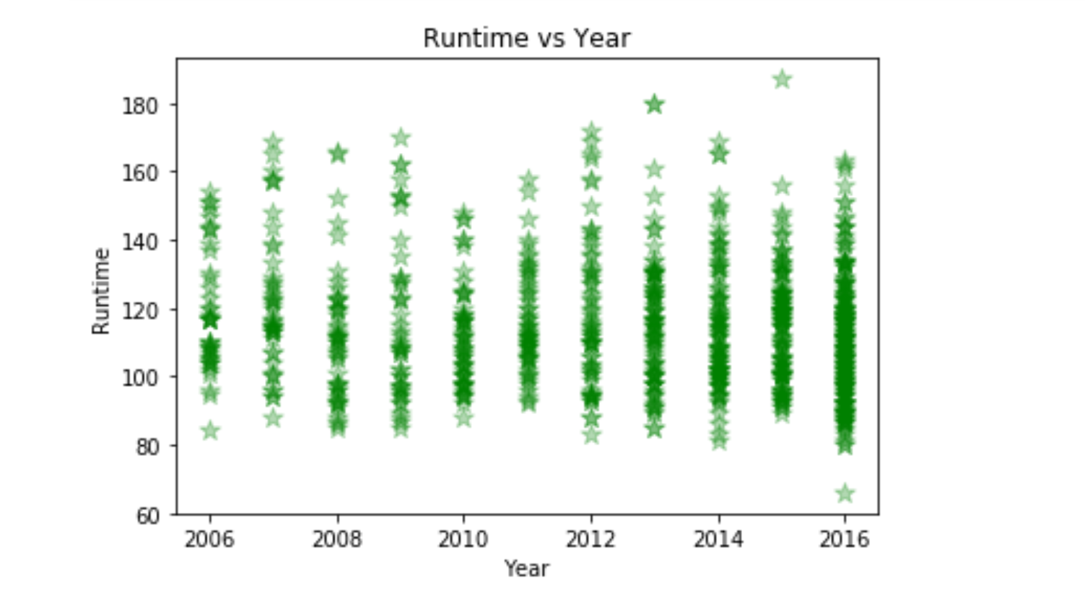
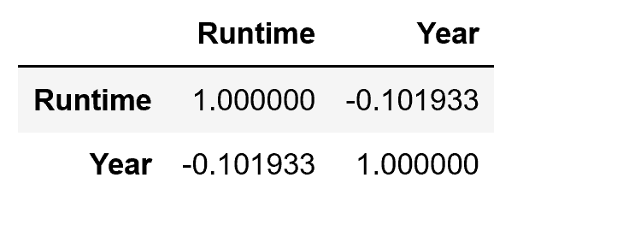
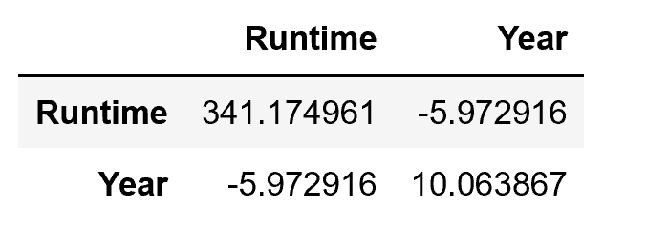
Scatterplot – Runtime variable with correlation and covariance
Pearson Correlation
Co-variance

Slide 11
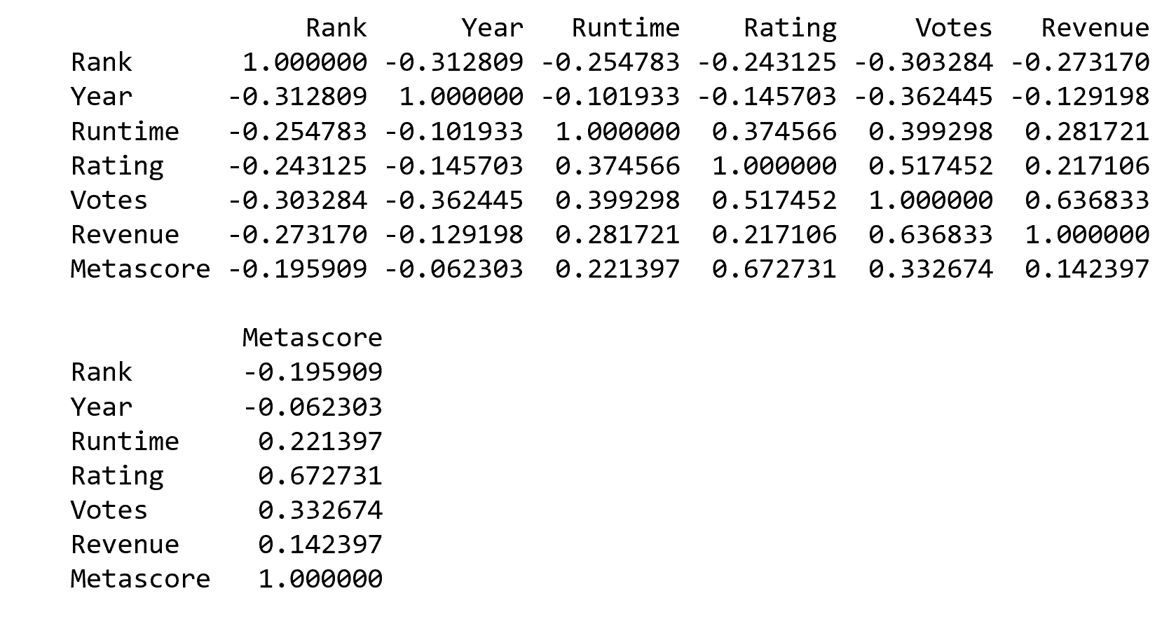

Correlation between all the variables

Slide 12
Hypothesis Testing – Chi-square test
I conducted the test on 4 different variables: Rating, Revenue, Runtime and Metascore.
Rating was the test I focused on, but I conducted tests on the additional variables just to check out the values and what effect it will have on the hypothesis.
Below are the chi-square statistic and P-value for Rating
Based on the p-value being greater than 0.05, I will not reject the null hypothesis

Slide 13
Regression Analysis
Dependent variable: Votes
Explanatory variables: Revenue, Rank & Year
After training an test the model and applying the model I received a multiple R square of 0.60.

Slide 14
Conclusion
Based on the analysis conducted, I believe the Votes and Rating columns have the strongest influence when choosing the most popular movies from 2006-2016.

